Slide 1
Making Education Easy: Organizing resources with the Campus Resource Hub application
AIDD Final Project | Team 6
Yennie Tran, Nithya Balachander, Quoc Anh (Alex) Ho, Cameron Lusby

Slide 2
What is the Campus Resource Hub?
The Campus Resource Hub is a web application designed for universities, allowing students, staff, and departments to easily list, discover, and book campus resources such as study rooms, equipment, labs, and event spaces.
Key Features
Centralized resource marketplace for campus resources (study rooms, equipment, event spaces, tutoring time)
Role-based access: Students, Staff, and Admins with different permissions
Search and discovery: Filter by category, location, capacity, and availability
Community features: Ratings, reviews, and messaging between users
What is It?
Student View
Staff View
Admin View
AI Development
Wireframe/ERD
2

Slide 3


Student View
Students can discover, book, and review campus resources with a streamlined interface focused on resource discovery and booking management.
Limitations
Search & Browse — Find resources by keyword, category, location, capacity
Student Role Features
- Resources require admin approval before being visible
- Cannot approve/reject bookings
- Cannot change resource status (during resource creation process… can’t draft or edit)
Book Resources & Manage Bookings -- book via calendar, view or cancel booking status, join waitlists
Personal Dashboard — Track My Resources, My Bookings, Messages, Reviews
Create Resources — Submit resources for admin approval (auto-set to draft)
Reviews & Ratings — Rate and review resources after completed bookings
Recommendation
3
Student View
Timeline
Context
Staff View
What is It?
Admin View
AI Development
Wireframe/ERD

Slide 4

Staff View
Staff have enhanced publishing capabilities, allowing them to create and publish resources immediately while managing bookings for their own resources
Limitations
Staff Role Features
Cannot moderate flagged reviews or reported messages
Cannot view, edit, suspend, or change users
Can only control their own resources
Booking Management — Approve/reject bookings for resources they own
All Student Features — Search, browse, book, review, message
No Approval Required — Resources visible immediately when published
Full Resource Control — Edit status and manage (publish, draft, or archive) their own resources
What is It?
Student View
Staff View
Admin View
AI Development
Wireframe/ERD
4

Slide 5


Admin View
Admins have full system control with comprehensive management tools, approval workflows, content moderation, and AI-powered analytics
Admin Dashboard
Content Moderation — Moderate flagged reviews and reported messages
Admin Role Features
Quick action buttons (approvals, users, resource etc. management in one view)
Can view system analytics (total users, resources, bookings, etc.)
Access to AI Summary Report
User & Resource Management — View, edit, suspend, users, approve/reject resources & bookings
Approval Queue — Approve/reject pending resources and bookings
Access to AI Summary Report — AI-powered system analytics and insights
Admin Logging — All actions logged for audit trail
What is It?
Student View
Staff View
Admin View
AI Development
Wireframe/ERD
5

Slide 6

AI Driven Development & AI Features
How AI built this project
Impacts from AI
AI Feature: Auto-Summary Reporter
Development tools:
Cursor AI was an assistant in code generation, debugging, and feature implementation
Quick prototyping with MVC structure and consistent use of it
Implementing new features or updating features was efficient and effective
Better code quality, as AI handles errors, recognizes security patterns, and suggests best practices
What it does: generates summaries of system statistics and trends using LLMs to turn raw data into readable insights.
Multiple LLM Support — Works with Ollama (local), LM Studio, or OpenAI API
Intelligent Fallback — If no LLM available, it will still create a summary, with a template instead
Comprehensive Analytics — Booking trends, top resources, ratings, category distribution
Context Development:
AI used project context to generate aligned code (ex. using wireframe to create html base)
**Note: All AI code reviewed and validated before integration.
Document of AI usage in dev_notes & golden_prompts
"Bookings increased 25% this week compared to last week"
What is It?
Student View
Staff View
Admin View
AI Development
Wireframe/ERD
6

Slide 7
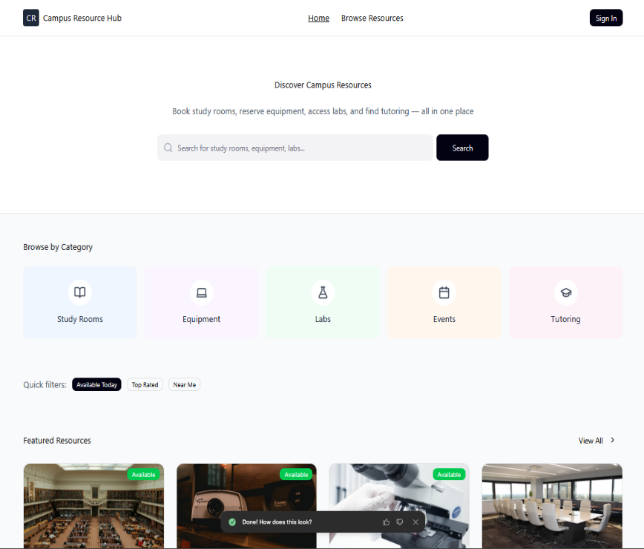
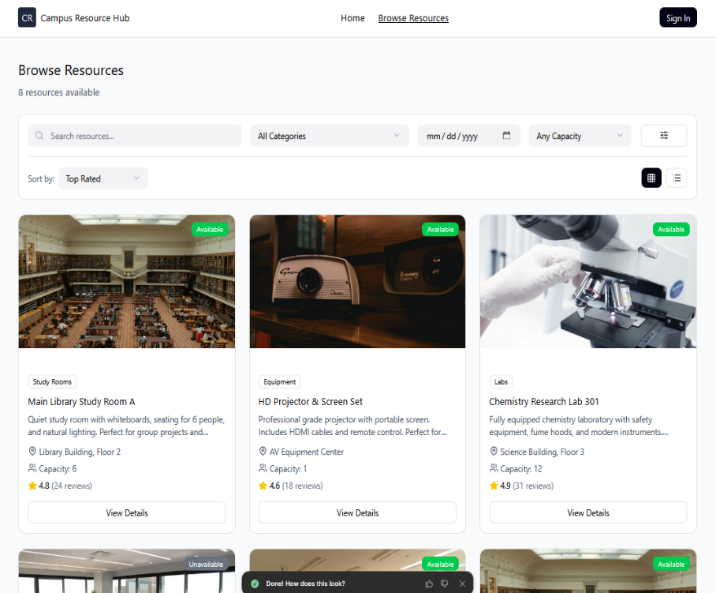
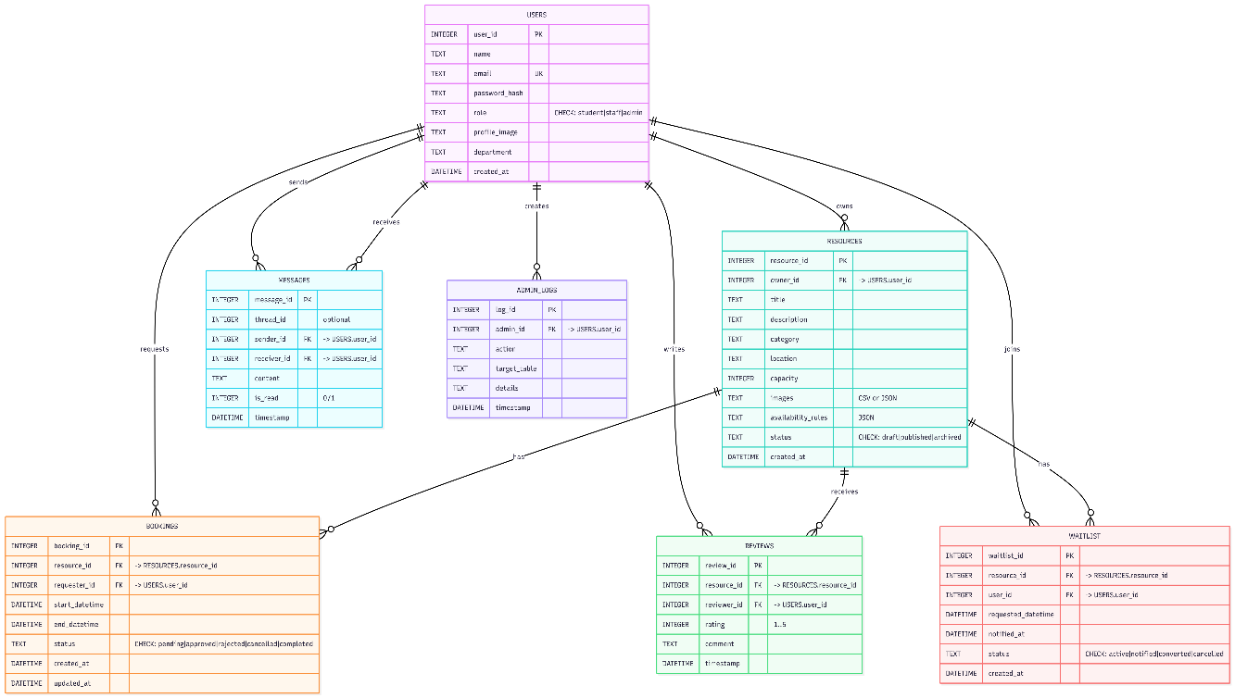
Wireframes & ERD
The wireframe for Campus Resource Hub was built on Figma. That was then put into /docs/context/DT to be used for content-driven development in Cursor. The wireframe gave a base idea/template to the html.
The ERD shows a relational database with Users at the center, connected to Resources, Bookings, Messages, Reviews, Waitlist, and Admin_logs through foreign key relationships
**Note: 2/6 wireframes are shown here as examples
What is It?
Student View
Staff View
Admin View
AI Development
Wireframe/ERD
7

